Slide 1

Mathematical Modeling of Six Database-Derived Gene Regulatory Networks Identifies Key Regulators and Network Properties Controlling the Early Response to Cold Shock in Saccharomyces cerevisiae
Brandon Klein
Department of Biology
Loyola Marymount University
Undergraduate Research Symposium
March 24, 2018

Slide 2
Outline
Yeast respond to cold shock by changing gene expression.
The transcription factors regulating the early
cold response are unknown.
GRNmap was used to model six candidate gene regulatory networks that might regulate the response to cold shock.
Comparative analysis of the networks with random networks reveals network motifs important for controlling the response.
Consolidated motifs inform further microarray experiments.

Slide 3
Outline
Yeast respond to cold shock by changing gene expression.
The transcription factors regulating the early
cold response are unknown.
GRNmap was used to model six candidate gene regulatory networks that might regulate the response to cold shock.
Comparative analysis of the networks with random networks reveals network motifs important for controlling the response.
Consolidated motifs inform further microarray experiments.

Slide 4
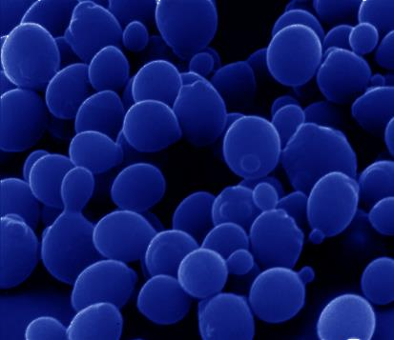
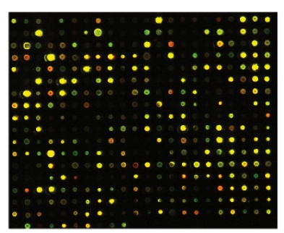
The Dahlquist Lab Studies Cold Shock Using DNA Microarrays
13°C
30% of genes exhibit significant changes in expression due to cold shock.
Ribosome biogenesis genes are upregulated.
Overlap with the Environmental Stress Response (ESR) in the late but not early response to low temperature stress.
Notes:
Impaired translation due to DNA/RNA secondary structure stabilization.

Slide 5
The Dahlquist Lab Studies Cold Shock Using DNA Microarrays
13°C
30% of genes exhibit significant changes in expression due to cold shock.
Ribosome biogenesis genes are upregulated.
Which transcription factors control the early response to cold shock in yeast?
What network motifs do these transcription factors form?
What are the indirect effects of other transcription factors in the gene regulatory network?
Notes:
Mention Overarching Goal: cracking gene regulatory code.

Slide 6
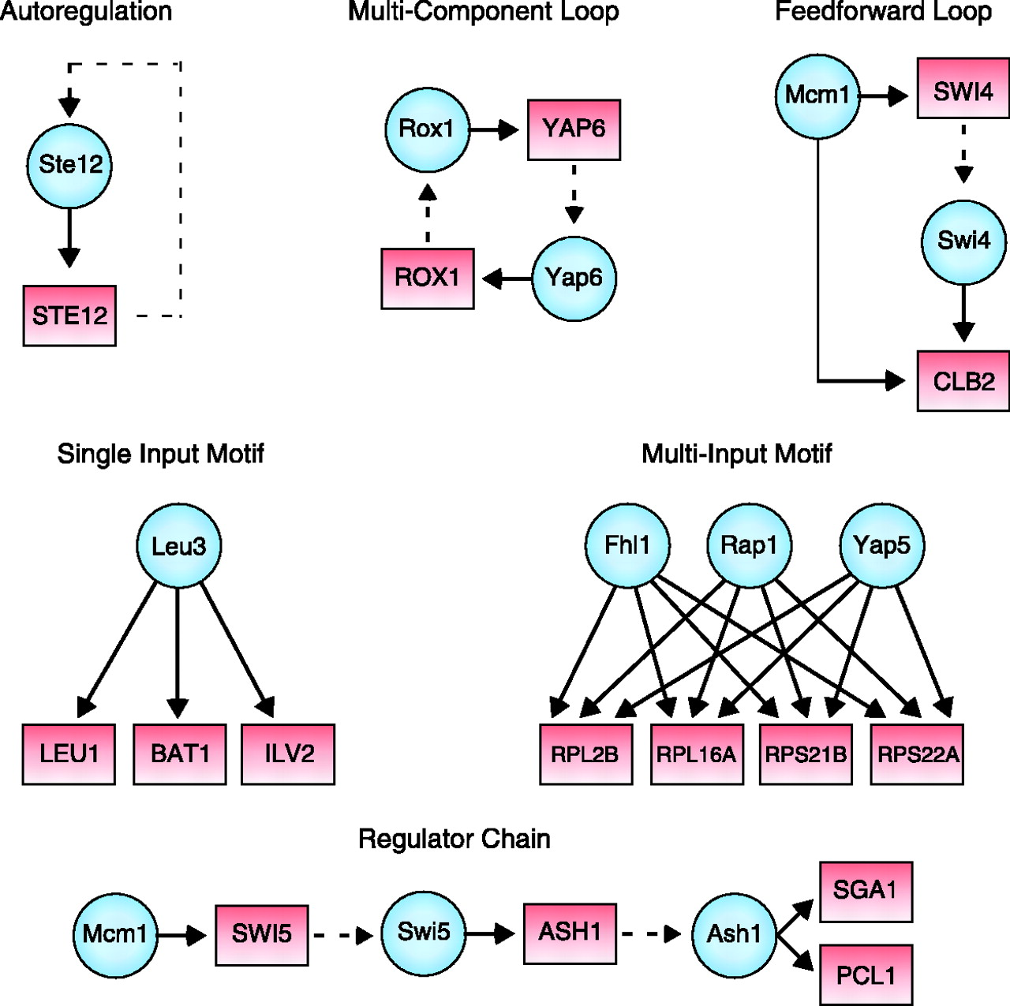
In Yeast, ~250 Transcription Factors Regulate the ~6000 Genes through Combinatorial Control
Common Network Motifs
Activators increase gene expression.
Repressors decrease gene expression.
Transcription factors are themselves proteins that are encoded by genes.
Transcription factors regulate one another, forming motifs and gene regulatory networks.
Lee et al. (2002)

Slide 7
Outline
Yeast respond to cold shock by changing gene expression.
The transcription factors regulating the early
cold response are unknown.
GRNmap was used to model six candidate gene regulatory networks that might regulate the response to cold shock.
Comparative analysis of the networks with random networks reveals network motifs important for controlling the response.
Consolidated motifs inform further microarray experiments.

Slide 8
GRNmap: Gene Regulatory Network Modeling and Parameter Estimation
The change in expression of one gene is production – degradation.
Weight parameter, w, gives the direction (activation or repression) and magnitude of the regulatory relationship.
Differential equation models are fit to microarray data using a penalized least squares approach.
E represents goodness-of-fit of model to the data.
http://kdahlquist.github.io/GRNmap/
Notes:
E: least square’s error
Transition from E to MSE:minMSE

Slide 9
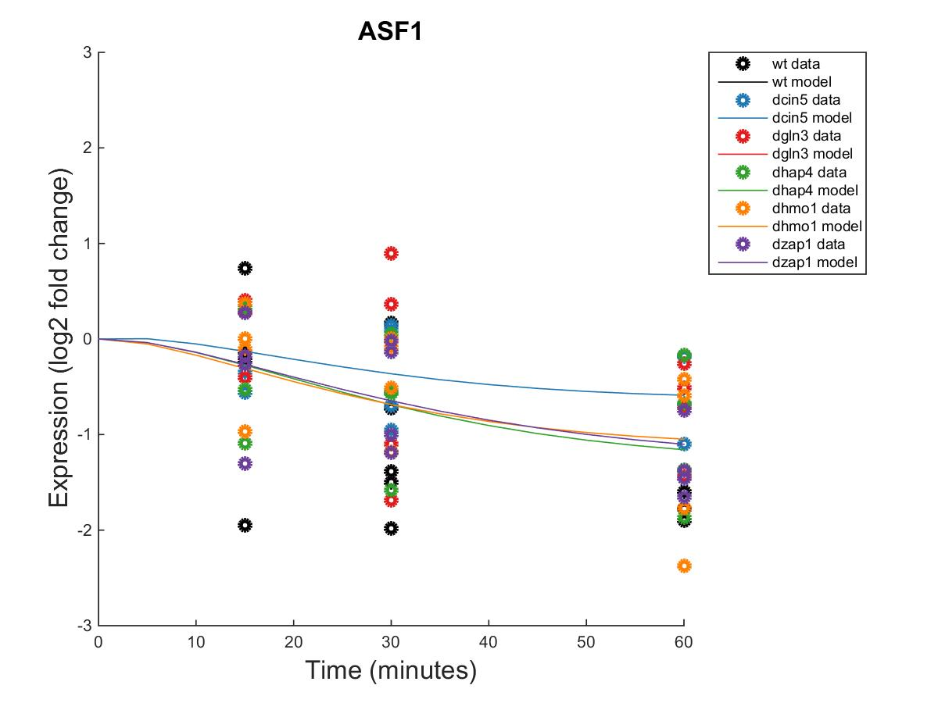
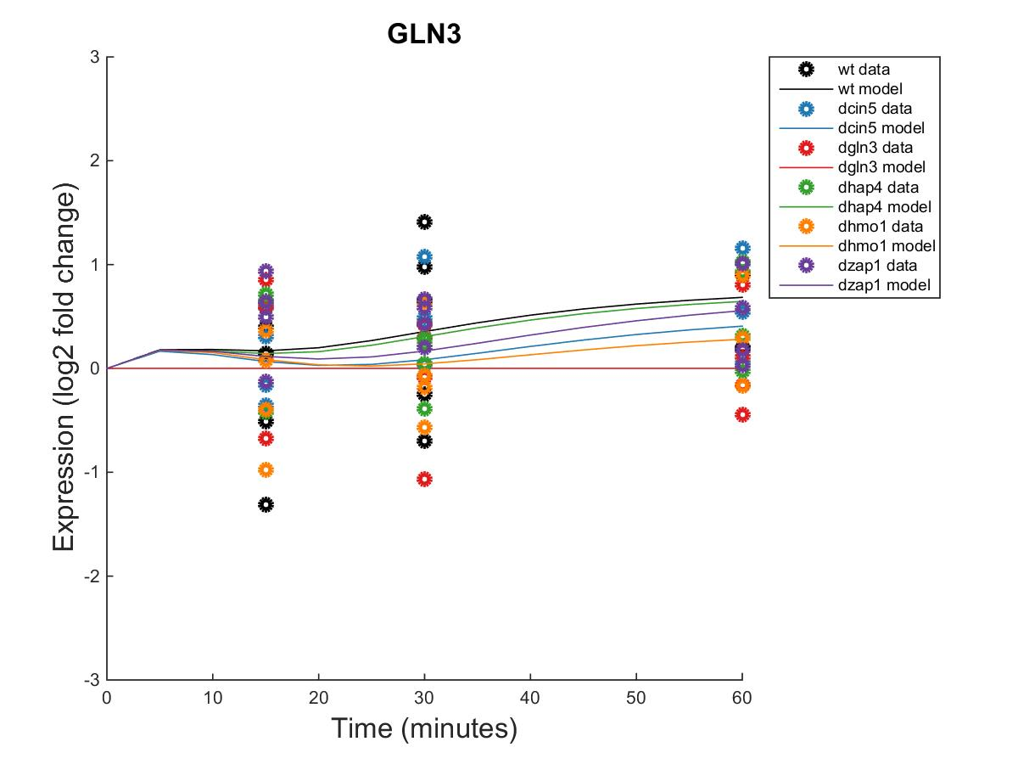
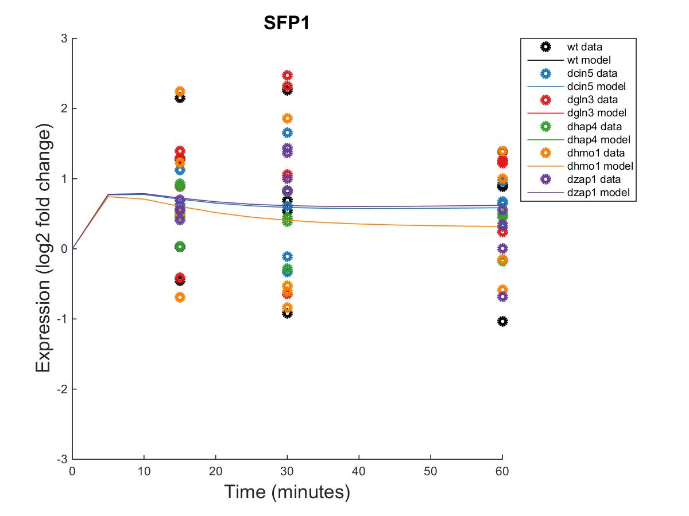
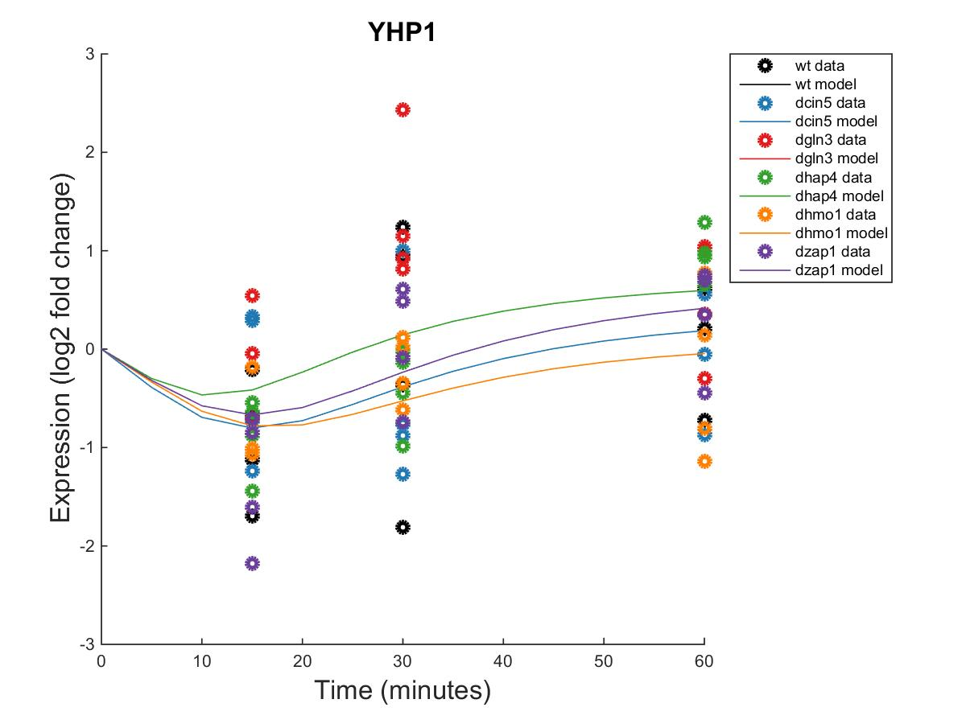
Forward Simulation of the Models Fits the Microarray Data Well
_{MSE:minMSE = 0.3695}
_{MSE:minMSE = 0.2209}
_{MSE:minMSE = 0.5337}
_{MSE:minMSE = 0.3662}
Notes:
Figure 2. Forward simulation of the wild-type derived network in GRNmap accurately modeled common expression profiles. Within-strain ANOVA p-values are overlain onto the expression plots automatically output by GRNmap, with color coding indicating individual strains from which input data was derived. MSE:minMSE ratio values averaged across all six strains are also reported, indicating the goodness-of-fit of the model data (lines) to the actual expression of each gene (circles).

Slide 10
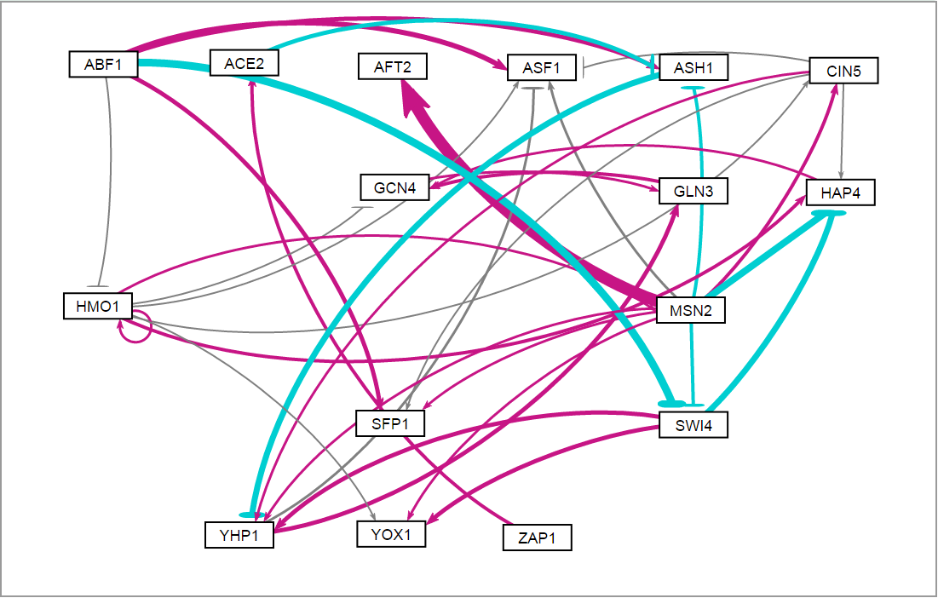
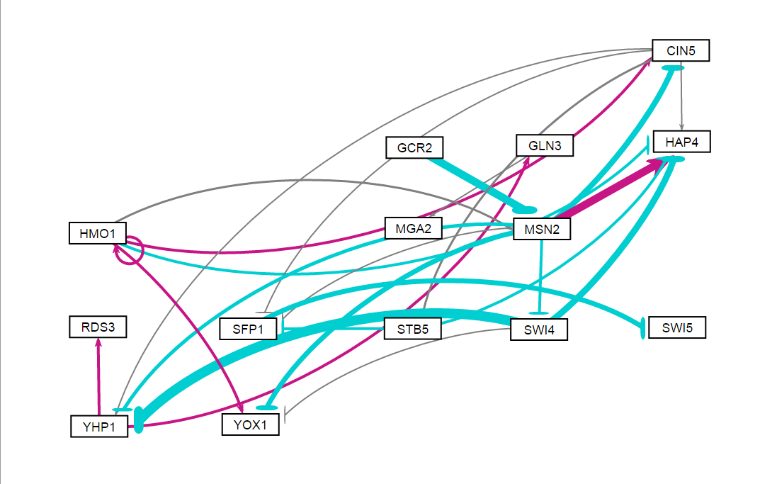
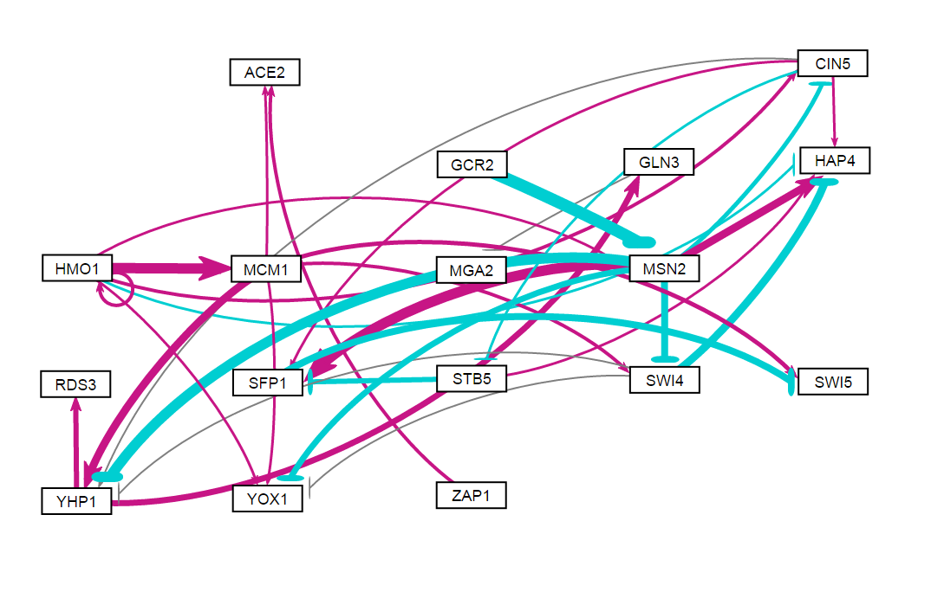
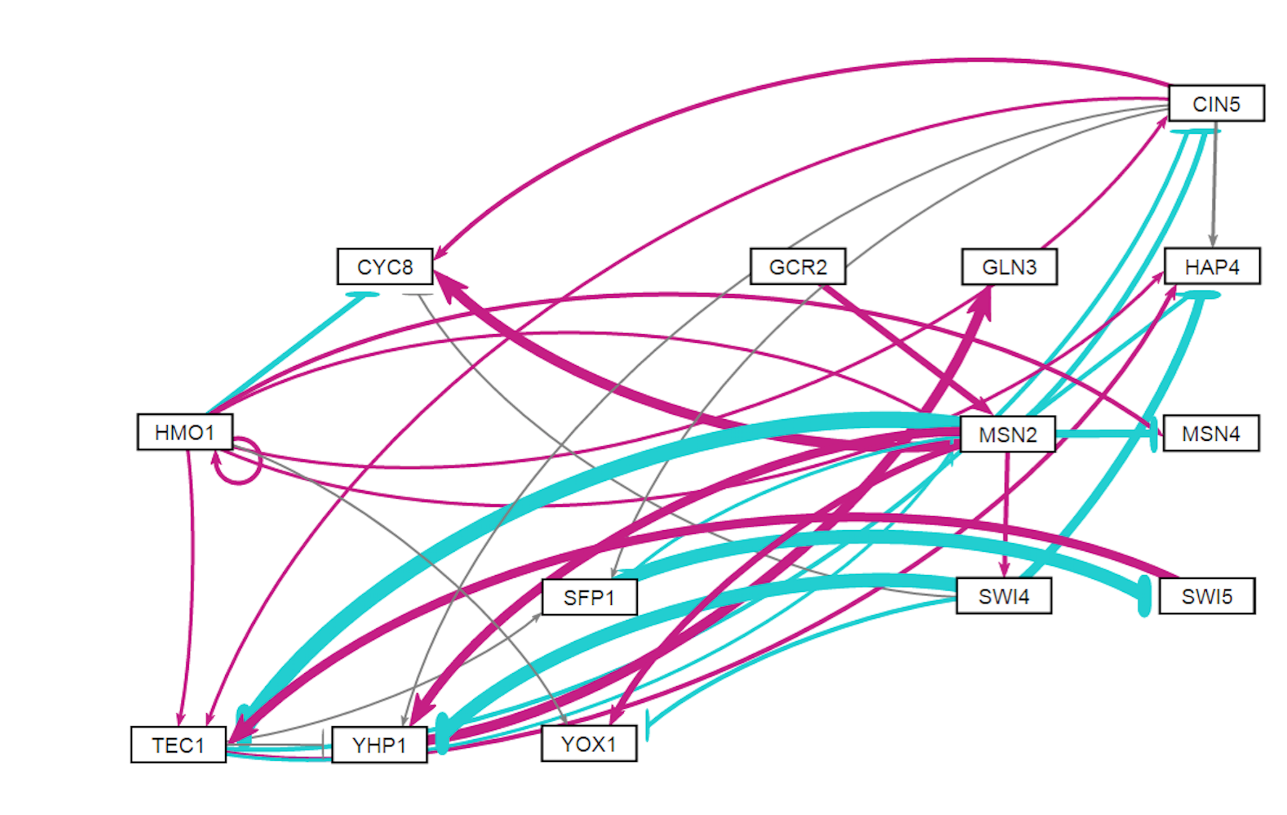
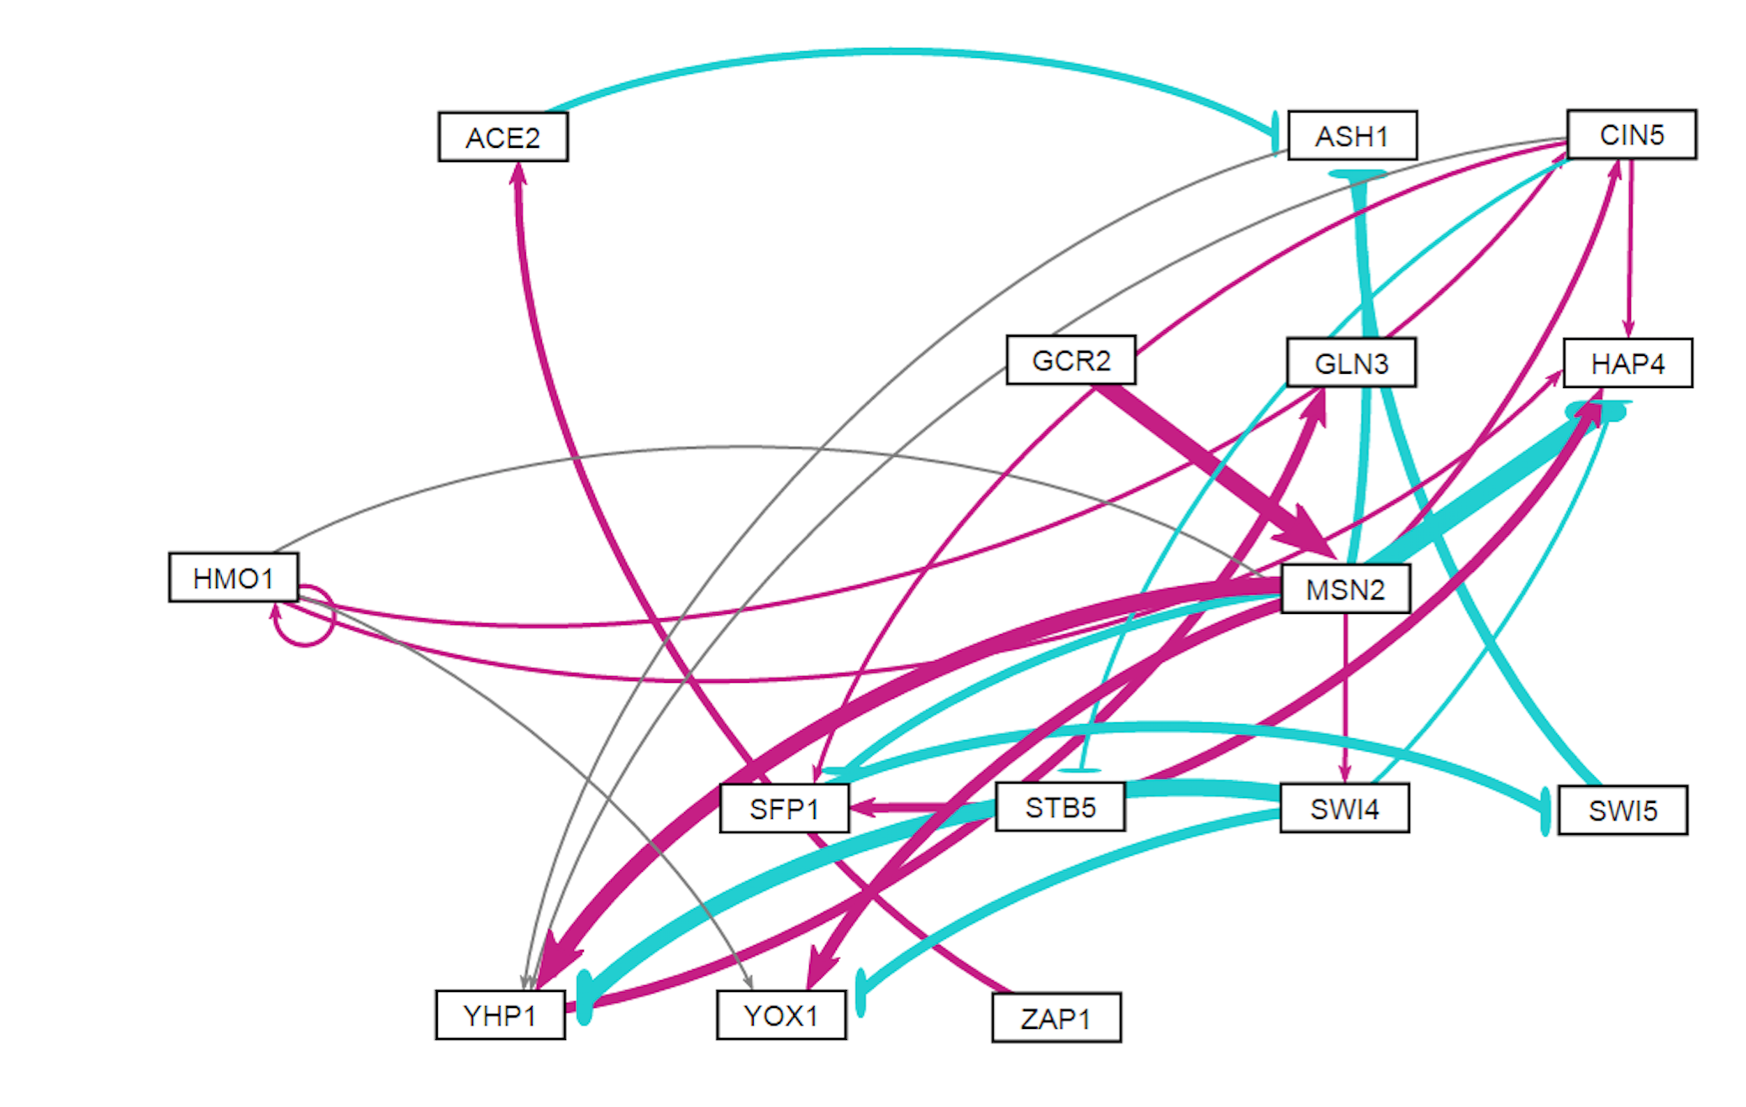
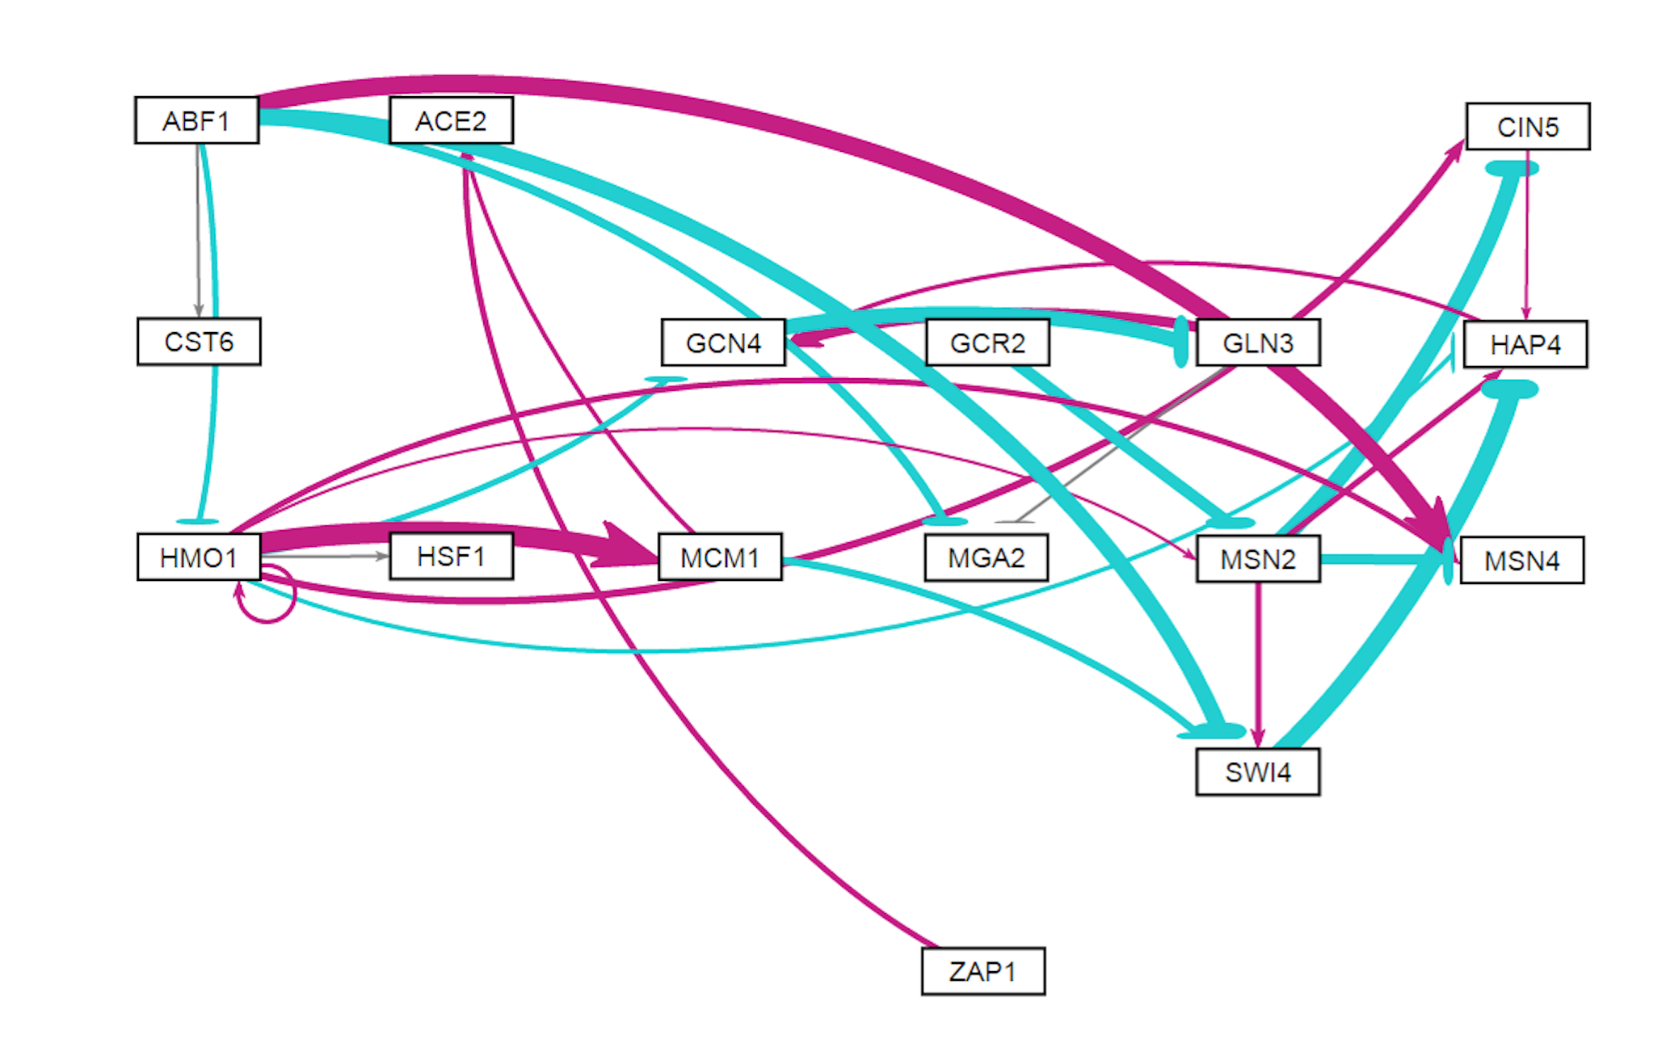
Six Related Gene Regulatory Networks Were Derived from the YEASTRACT Database
db1: 16 Genes, 26 Edges
LSE:minLSE = 1.42
db2: 14 Genes, 25 Edges
LSE:minLSE = 1.36
db3: 17 Genes, 32 Edges
LSE:minLSE = 1.41
db4: 14 Genes, 35 Edges
LSE:minLSE = 1.30
db5: 15 Genes, 28 Edges
LSE:minLSE = 1.43
db6: 16 Genes, 27 Edges
LSE:minLSE = 1.40
Notes:
Figure 4. GRNsight visualization highlights salient features of db1-db6. Transcription factors are represented by boxes and arranged in a consistent array. Regulatory relationships are represented by arrows directed from regulator to target. Pointed arrowheads and magenta coloration indicate activation, whereas flat arrowheads and cyan coloration indicate repression. Edges colored in grey exhibit small influence, meaning their associated weights are <5% of the maximum edge weight in the network.
Enlarge images of networks, present 2 per row, or rotate CCW 90 degrees.

Slide 11
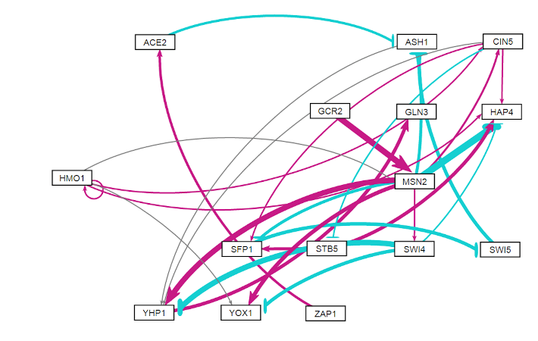
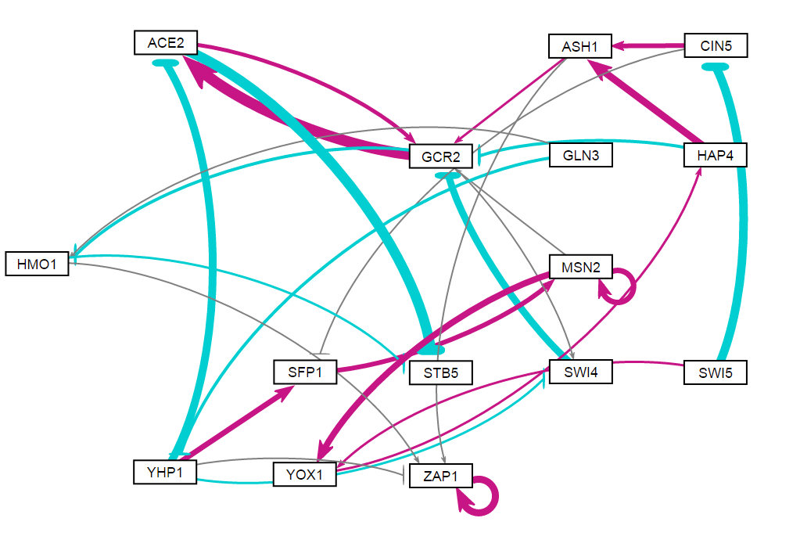
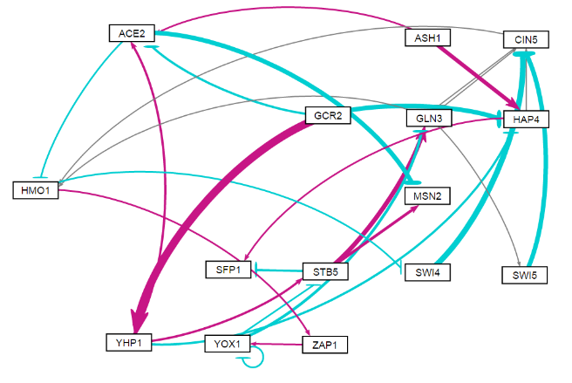
Db5 Outperforms 30 Random Networks Containing the Same Genes and Numbers of Edges
Ratio of the Observed Least Squares Error to the Minimum Theoretical Least Squares Error
db5
rand24
rand7
Notes:
Figure 8. The network derived from ∆hap4 strain data, db5, generally outperformed 30 random networks composed of the same transcription factors and containing the same number of edges. The LSE:minLSE ratios for db1-db6 are reported on the left and for the thirty random networks on the right. The arrows indicate the bars corresponding to db5 (black), the three best performing random networks (green), and the three worst performing random networks (purple). A horizontal line is drawn demarcating the LSE:minLSE ratio of db5 for comparison.

Slide 12
Multiple Regression Analyses Identified Determinants of Individual Transcription Factor Model Fits
 | Database-Derived Networks |  |  |  |  |  |  | 3 Best Random Networks |  |  |  | 3 Worst Random Networks
 | db1 | db2 | db3 | db4 | db5 | db6 |  | rand15 | rand16 | rand24 |  | rand7 | rand12 | rand31
ANOVA B&H p-value
Average Expression at 15 min. | -0.507 | -0.624 | -0.479 | -0.552 | -0.528 | -0.626 |  |  |  |  |  | -0.838 |  | -0.656
Average Expression at 30 min.
Average Expression at 60 min. |  |  |  |  |  |  |  |  |  |  |  |  | -0.503
Degradation Rate |  |  |  |  |  |  |  | -0.505 |  | -0.611
Optimized Production Rate | 0.578 |  |  | 0.777 |  | 0.437
Optimized Threshold b |  |  |  | 0.883
Weighted In-degree |  |  |  |  |  | 0.617
Weighted Out-degree |  |  |  |  |  |  |  | -0.627 |  |  |  | 0.433
Eccentricity
Closeness Centrality |  |  |  |  |  |  |  | -0.443
Betweenness Centrality |  |  |  |  |  |  |  |  | -0.609 |  |  | 0.399
Clustering |  | 0.522 | 0.473 |  | 0.501
Eigenvector Centrality | -0.384 |  |  | -0.533 |  | -0.328 |  |  |  | -0.598 |  |  | -0.685 | -0.831
Modularity Class | — | — | — | — | — | — |  |  |  |  |  |  | 0.510
Page Ranks | — | — | — | — | — | — |  |  |  |  |  |  |  | 0.633
Strong Component Number | — | — | — | — | — | — |  |  | 0.633 |  |  |  | -1.033
Adjusted R² | 0.290 | 0.525 | 0.360 | 0.441 | 0.350 | 0.196 |  | 0.436 | 0.552 | 0.257 |  | 0.500 | 0.692 | 0.437
Factors that were not significant predictors of MSE:minMSE ratio: ANOVA B&H p-value, Average Expression at 30 minutes, Eccentricity
Factors that were consistently significant predictors of MSE:minMSE ratio: Average Expression at 15 minutes, Eigenvector Centrality
Notes:
Figure 9. LSE:minLSE Ratio of Random Networks vs. # of Regulatory Relationships Shared with db5. The vertical line indicated the median number of regulatory relationships shared with db5 (2). The horizontal line marks the LSE:minLSE ratio of db5 (1.4263).
CALL BACK TO MSE:MINMSE
(AS MAGGIE SHOWED ECCENTRICITY VS. EIGENVECTOR CENTRALITY)

Slide 13
Outline
Yeast respond to cold shock by changing gene expression.
The transcription factors regulating the early
cold response are unknown.
GRNmap was used to model six candidate gene regulatory networks that might regulate the response to cold shock.
Comparative analysis of the networks with random networks reveals network motifs important for controlling the response.
Consolidated motifs inform further microarray experiments.

Slide 14
Modeling Revealed Consistent Regulatory Relationships Among Sets of Transcription Factors
 | db1 | db2 | db3 | db4 | db5 | db6 |  | db1 | db2 | db3 | db4 | db5 | db6
ABF1->ASF1 |  |  |  |  |  |  | MCM1->SWI4
ABF1->ASH1 |  |  |  |  |  |  | MCM1->SWI5
ABF1->CST6 |  |  |  |  |  |  | MCM1->YHP1
ABF1->HMO1 |  |  |  |  |  |  | MCM1->YOX1
ABF1->MGA2 |  |  |  |  |  |  | MSN2->AFT2
ABF1->MSN4 |  |  |  |  |  |  | MSN2->ASF1
ABF1->SFP1 |  |  |  |  |  |  | MSN2->ASH1
ABF1->SWI4 |  |  |  |  |  |  | MSN2->CIN5
ACE2->ASH1 |  |  |  |  |  |  | MSN2->CYC8
ASH1->YHP1 |  |  |  |  |  |  | MSN2->HAP4
CIN5->ASF1 |  |  |  |  |  |  | MSN2->MSN4
CIN5->CYC8 |  |  |  |  |  |  | MSN2->SFP1
CIN5->HAP4 |  |  |  |  |  |  | MSN2->SWI4
CIN5->SFP1 |  |  |  |  |  |  | MSN2->TEC1
CIN5->STB5 |  |  |  |  |  |  | MSN2->YHP1
CIN5->TEC1 |  |  |  |  |  |  | MSN2->YOX1
CIN5->YHP1 |  |  |  |  |  |  | SFP1->SWI5
GCN4->GLN3 |  |  |  |  |  |  | STB5->HAP4
GLN3->GCN4 |  |  |  |  |  |  | STB5->SFP1
GLN3->MGA2 |  |  |  |  |  |  | SWI4->CYC8
GCR2->MSN2 |  |  |  |  |  |  | SWI4->HAP4
HAP4->GCN4 |  |  |  |  |  |  | SWI4->YHP1
HMO1->ASF1 |  |  |  |  |  |  | SWI4->YOX1
HMO1->CIN5 |  |  |  |  |  |  | SWI5->ASH1
HMO1->CYC8 |  |  |  |  |  |  | SWI5->TEC1
HMO1->GCN4 |  |  |  |  |  |  | TEC1->CIN5
HMO1->HAP4 |  |  |  |  |  |  | TEC1->HAP4
HMO1->HMO1 |  |  |  |  |  |  | TEC1->MSN2
HMO1->HSF1 |  |  |  |  |  |  | TEC1->SFP1
HMO1->MCM1 |  |  |  |  |  |  | TEC1->YHP1
HMO1->MSN2 |  |  |  |  |  |  | YHP1->ASF1
HMO1->MSN4 |  |  |  |  |  |  | YHP1->GLN3
HMO1->TEC1 |  |  |  |  |  |  | YHP1->RDS3
HMO1->YOX1 |  |  |  |  |  |  | ZAP1->ACE2
MCM1->ACE2
Maximum: 1
Minimum : -1
Notes:
Table 5. Heat map visualizing regulatory weights for each of the sixty-nine edges represented in db1-db6. Positive weights are indicated by red and negative weights by blue. Darker shades correspond to higher magnitude weights. All values were normalized to the largest magnitude weight, MSN2→AFT2, in db1.
USE TO TRANSITION TO NEXT SLIDE ONLY.

Slide 15
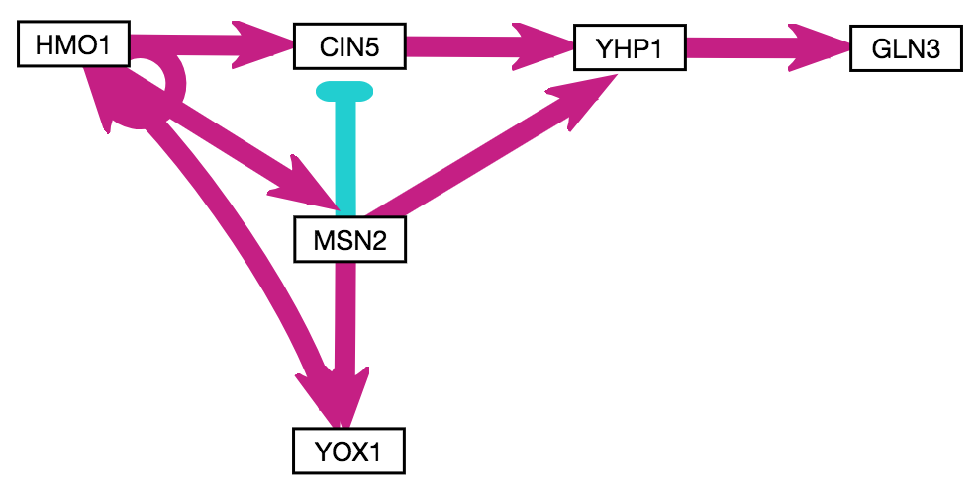
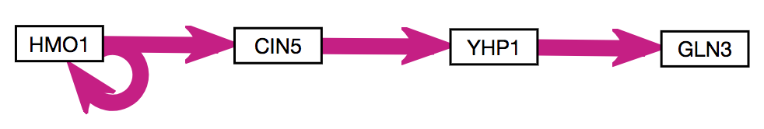
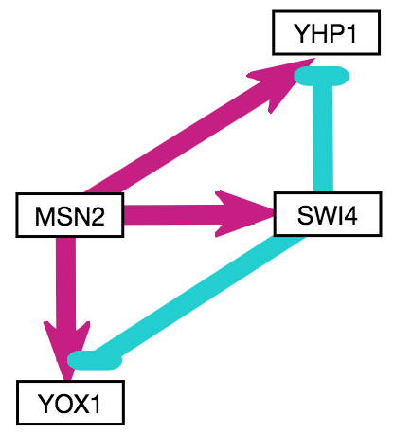
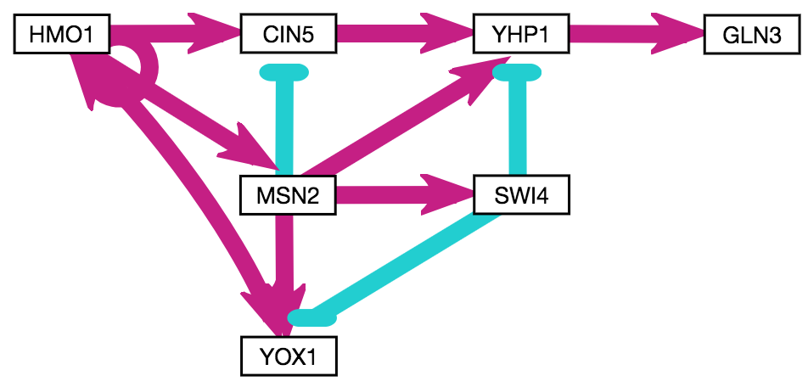
Motifs Conserved in the Database-Derived Networks were Identified
A
B
C
D
Regulator Chains &
5 Feedforward Loops
Notes:
Figure 6. Conserved motifs in the six database-derived GRNs include regulatory chains and feedforward loops (FFLs). A regulatory chain comprised of HMO1, CIN5, YHP1, and GLN3 exhibited consistent activation in five GRNs (A). Addition of MSN2, YOX1, and their associated edges (which were weighted based on frequency) to the regulatory chain yielded a system of 3 FFLs (B). MSN2 also forms symmetrical FFLs mediated by SWI4 that terminate on the paralogs YHP1 and YOX1, which most frequently appear as incoherent type 1 FFLs (C). Addition of the described motifs (A-C) yields a conserved system containing 5 FFLs and a regulatory chain (D). Boxes indicate genes and arrows indicate edges, with pointed arrowheads representing activation (magenta) and flat arrowheads repression (cyan).

Slide 16
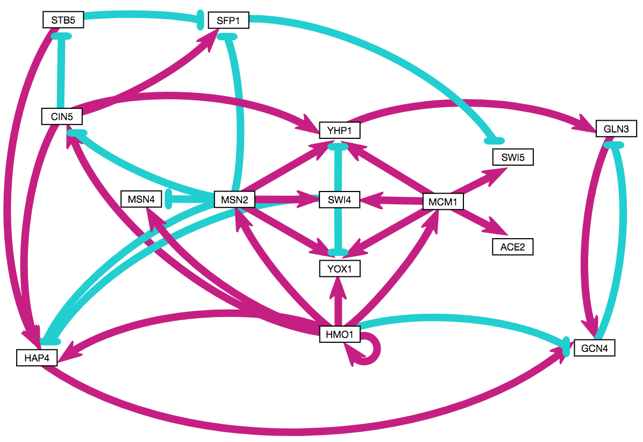
A Consolidated Network was Constructed from Conserved Motifs and High Eigenvector Centrality Genes
The consolidated network contains 15 genes and 34 edges.
Notes:
15 genes, 34 edges (highly connected; most similar to db4 in this respect, which had lowest LSE:minLSE ratio but also included TEC1).
Colored pairs = paralogs.
Orange borders = known cold-sensitive phenotypes on SGD.
Green borders = tested by Dahlquist lab.
Light grey shading = appears distinct from ESR (not MSN2/4 mediated).
GCN4 has eigen of 1 in both nSFP1 in 5/6 networks + high eigen + consistent repression of SWI5.
etworks where it appears… connects disparate “modules” and created negative feedback loop.
Nodes that did not make it: TEC1 (highly connected, but 1 network), GCR2 (5/6, but negligible experimental expression ∆), CST6 (known cold phenotype, but only connected to ABF1, which is not in this GRN).

Slide 17
The Consolidated Network Exhibits Similar Patterns of Paralog Signaling
ACE2/SWI5 and YHP1/YOX1 regulate the cell cycle.
MSN2/MSN4 regulate the environmental stress response.
Notes:
15 genes, 34 edges (highly connected; most similar to db4 in this respect, which had lowest LSE:minLSE ratio but also included TEC1).
Colored pairs = paralogs.
Orange borders = known cold-sensitive phenotypes on SGD.
Green borders = tested by Dahlquist lab.
Light grey shading = appears distinct from ESR (not MSN2/4 mediated).
GCN4 has eigen of 1 in both nSFP1 in 5/6 networks + high eigen + consistent repression of SWI5.
etworks where it appears… connects disparate “modules” and created negative feedback loop.
Nodes that did not make it: TEC1 (highly connected, but 1 network), GCR2 (5/6, but negligible experimental expression ∆), CST6 (known cold phenotype, but only connected to ABF1, which is not in this GRN).

Slide 18
The Consolidated Network Exhibits Overlap with the Environmental Stress Response (ESR)
The ESR is MSN2/4-dependent but represses ribosome biogenesis.
HMO1 induces TORC1-dependent upregulation of ribosome biogenesis.
Notes:
15 genes, 34 edges (highly connected; most similar to db4 in this respect, which had lowest LSE:minLSE ratio but also included TEC1).
Colored pairs = paralogs.
Orange borders = known cold-sensitive phenotypes on SGD.
Green borders = tested by Dahlquist lab.
Light grey shading = appears distinct from ESR (not MSN2/4 mediated).
GCN4 has eigen of 1 in both SFP1 in 5/6 networks + high eigen + consistent repression of SWI5.
etworks where it appears… connects disparate “modules” and created negative feedback loop.
Nodes that did not make it: TEC1 (highly connected, but 1 network), GCR2 (5/6, but negligible experimental expression ∆), CST6 (known cold phenotype, but only connected to ABF1, which is not in this GRN).

Slide 19
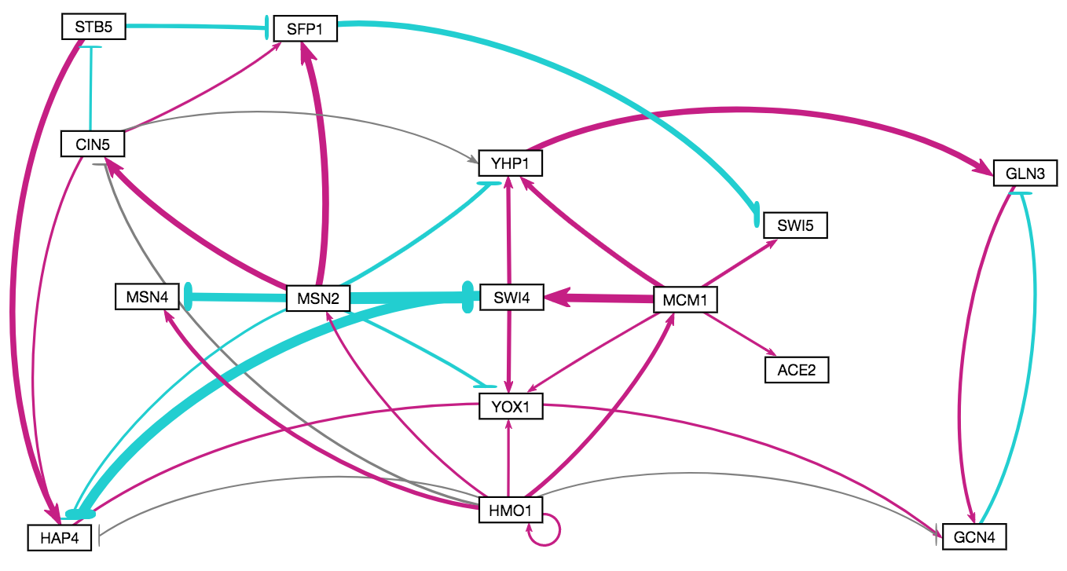
Modeling Results Support the Validity of the Consolidated Network
LSE:minLSE = 1.34.
25 out of 34 regulatory relationships predicted correctly.
Notes:
15 genes, 34 edges (highly connected; most similar to db4 in this respect, which had lowest LSE:minLSE ratio but also included TEC1).
Colored pairs = paralogs.
Orange borders = known cold-sensitive phenotypes on SGD.
Green borders = tested by Dahlquist lab.
Light grey shading = appears distinct from ESR (not MSN2/4 mediated).
GCN4 has eigen of 1 in both nSFP1 in 5/6 networks + high eigen + consistent repression of SWI5.
etworks where it appears… connects disparate “modules” and created negative feedback loop.
Nodes that did not make it: TEC1 (highly connected, but 1 network), GCR2 (5/6, but negligible experimental expression ∆), CST6 (known cold phenotype, but only connected to ABF1, which is not in this GRN).

Slide 20
Outline
Yeast respond to cold shock by changing gene expression.
The transcription factors regulating the early
cold response are unknown.
GRNmap was used to model six candidate gene regulatory networks that might regulate the response to cold shock.
Comparative analysis of the networks with random networks reveals network motifs important for controlling the response.
Consolidated motifs inform further microarray experiments.

Slide 21
Conclusions and Future Directions
Which transcription factors control the early response to cold shock?
Modeling results suggest Hmo1, Msn2, and Swi4 play
important roles.
What network motifs do these transcription factors form?
An activating regulator chain initiated by Hmo1.
FFLs mediated by Swi4 that terminate on the paralogs Yhp1 and Yox1.
What are the indirect effects of other transcription factors in the gene regulatory network?
Promising targets for study include the viable double deletion strains ∆yhp1∆yox1 and ∆msn2∆msn4.
Single deletion mutants are not cold-sensitive.

Slide 22

GRNsight: http://dondi.github.io/GRNsight/ GRNmap: http://kdahlquist.github.io/GRNmap/
Back row (left to right)
Nika Vafadari
Brandon Klein
Maggie O’Neil
Natalie Williams
Front row (left to right)
Anindita Varshneya
Monica Hong
Kam Dahlquist
Katherine Scheker
Not pictured
John David N. Dionisio
Ben G. Fitzpatrick
Lauren Kelly
John Lopez
Justin Kyle Torres
Funding: NSF RUI, Kadner-Pitts Research Grant, LMU SURP,
LMU Honors Program, LMU Rains Research Assistant Program

Slide 23
Please Visit Our Colleagues!
Oral Session VI, Room 1405, 3:10pm-4:25pm.
Back row (left to right)
Nika Vafadari
Brandon Klein
Maggie O’Neil
Natalie Williams
Front row (left to right)
Anindita Varshneya
Monica Hong
Kam Dahlquist
Katherine Scheker
Not pictured
John David N. Dionisio
Ben G. Fitzpatrick
Lauren Kelly
John Lopez
Justin Kyle Torres
Funding: NSF RUI, Kadner-Pitts Research Grant, LMU SURP,
LMU Honors Program, LMU Rains Research Assistant Program
Notes:
Systems Biology Workflow

